Slide 1
Secure Data Hiding in Image Using Steganography
CAPSTONE PROJECT
Presented By: MOHD KAISH SHEKH
Student Name : MOHD KAISH SHEKH
College Name & Department : GOEL INSTITUTE OF TECHNOLOGY AND MANAGEMENT LUCKNOW & COMPUTER SCIENCE DEPARTMENT

Slide 2
OUTLINE
Problem Statement
Technology used
Wow factor
End users
Result
Conclusion
Git-hub Link
Future scope

Slide 3
Problem Statement
The increasing need for secure communication has led to the development of techniques for hiding sensitive information.
Traditional encryption methods may draw attention; steganography provides a covert way to hide data.
This project aims to securely hide messages within images using steganography with password protection.

Slide 4
Technology used
Python
OpenCV (for image processing)
NumPy (for data manipulation)

Slide 5
Wow factors
Password protection ensures only authorized users can extract the hidden message.
Supports lossless image formats (e.g., PNG) for accurate data retrieval.
Implements robust error handling for incorrect password entries.

Slide 6
End users
Cybersecurity professionals seeking covert data transfer.
Individuals needing secure communication channels.
Researchers and developers working on data hiding techniques.

Slide 7
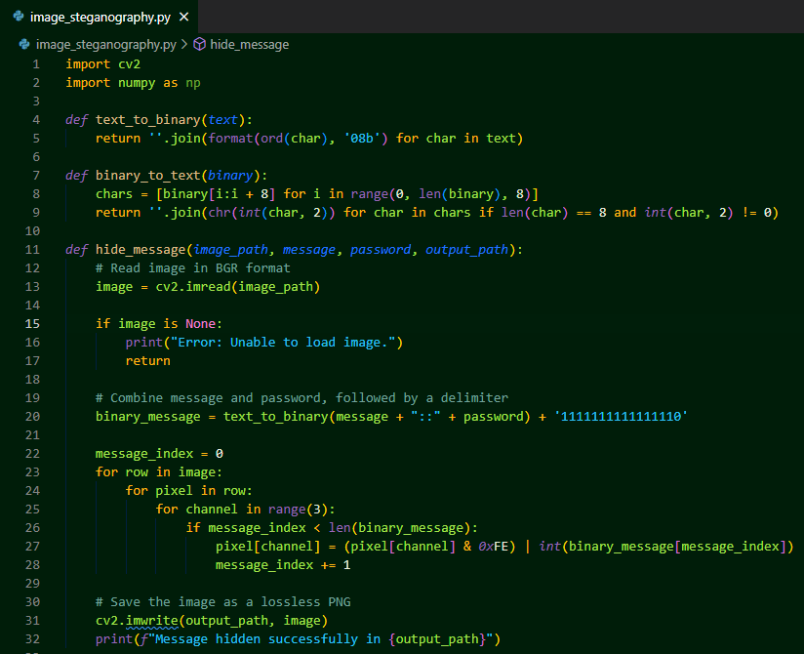
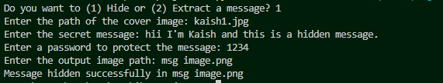

Results
Hide a Message
Extract a Message

Slide 8
Conclusion
This project effectively demonstrates secure data hiding using image steganography.
Password protection ensures confidentiality and prevents unauthorized access.
Provides a practical and reliable method for covert communication.

Slide 9

GitHub Link
https://github.com/MKaish/image-steganography.git

Slide 10
Future scope(optional)
Integrate advanced encryption algorithms for enhanced security.
Expand support to multimedia formats like audio and video.
Develop a user-friendly graphical interface (GUI) for easier use.

Slide 11
THANK YOU

